Slide 1
DDoS Attack Prevention
By
Prof. (Dr.) Anand Nayyar
School of Computer Science and AI
Duy Tan University, Viet Nam
1

Slide 2
Overview
What is a DDoS?
DDoS threats and trends
How does a DDoS work?
Details on reflection and amplification techniques
Mitigation strategies for inbound DDoS
Mitigation strategies for outbound DDoS
1

Slide 3
What is DoS and DDoS?
In general, a denial of service is an attack against availability of a service
  A service can be a network, or a specific service such as a web site
DoS - Denial of Service
  Usually from only one source
  Can be caused by resource exhaustion, or targeted exploitation
DDoS - Distributed Denial of Service
  Attack originates from multiple sources
  This is caused through resource exhaustion
1

Slide 4
Impacts of a DDoS
Users sees DDoS as an outage
Security team sees DDoS as a loss of availability
  Think back to CIA triad Confidentiality, Integrity, Availability
Business management, sees DDoS as impacting the business financially
  Especially if the business makes money using the Internet
    ISP, credit card gateway, online casino, online gaming
What is the cost per hour of your network or services being unavailable? (not including reputation damage)
1

Slide 5
DoS and DDoS by Traffic
DDoS traffic is largely grouped into these categories:
  Bandwidth exhaustion
    If the attacker has access to more bandwidth than the victim, then the attacker can send any traffic to flood the victim’s network connection, denying legitimate access to all services on the network
  Connection exhaustion
    If the victim’s services have a limited number of concurrent sessions/ connections, then the attacker can open more sessions faster than the victim can expire/close the sessions, denying legitimate access to the service. A similar attack uses a high number of packets per second against routers and other networking equipment, exhausting their routing processors.
  Targeted exploitation
    Usually executed as a single source DoS, these attacks exploit a weakness in the OS, application, or physical components to crash, reboot, or otherwise deny access to a service
1

Slide 6
DoS and DDoS by Layers
Protocols and
Services
OSI Model
TCP/IP Model
Attacks
Reflection and
Amplification
(DNS, NTP, SSDP, etc),
Slowloris, SIP Flood, Complex DB Queries
SYN Flood
Application
HTTP, FTP, DHCP, NTP, TFTP, DNS
Presentation
Application
Session
Transport
Transport
TCP, UDP
Network
Internet
IP, ICMP, RIP
ICMP Flood, IP Fragmentation
Data Link
Wi-Fi De-auth & Jamming Electrical Interference Construction Equipment
Network
Access
WiFi, Ethernet, Fiber, Copper
Physical
* Colour animated slide
1

Slide 7
DDoS Trends
DDoS attacks have changed and grown over the years
Connection exhaustion attacks are hard to track and report
Bandwidth attacks are commonly reported
  2.3Tbps attack against AWS – Feb 2020
  1.7Tbps attack (unnamed US victim) – March 2019
  1.3Tbps attack against GitHub – Feb 2018
  1.2Tbps attack against Dyn DNS - 2016
  500Gbps attack against HK Apple Daily/PopVote – June 2014
  300Gbps attack against Spamhaus – March 2013
  60Gbps attacks against several US banks – Late 2012
Reports show the average DDoS is 1-25Gbps and lasts <4h
1

Slide 8
Anatomy of a Plain DoS Attack
1
Attacker sends any valid or
invalid traffic to the victim
Attacker
Victim
1

Slide 9



Anatomy of a Plain DDoS Attack
1
Attacker directs
bots to begin attack
2
All bots send any valid or invalid traffic to the victim
BOT
BOT
BOT
BOT
BOT
Victim
Attacker
Botnet
1

Slide 10


Anatomy of a Reflected Amplification Attack
1
Attacker directs bots to begin attack
2
All bots send DNS queries for the TXT record in domain “evil.com”
to open recursive DNS servers and fake "my IP is 10.10.1.1"
BOT
BOT
BOT
BOT
BOT
Open recursive DNS servers
Attacker
Botnet
3
5
Open resolvers ask the authoritative name server for the TXT record “evil.com”
Open resolvers cache the response and send a stream of 4000 byte DNS responses to the victim
4
evil.com name server responds with 4000 byte TXT records
Victim (10.10.1.1)
evil.com authoritative name server
1

Slide 11
Reflection and Amplification
What makes for good reflection?
  UDP
    Spoofable / forged source IP addresses
    Connectionless (no 3-way handshake)
What makes for good amplification?
  Small command results in a larger reply
    This creates a Bandwidth Amplification Factor (BAF)
    Reply Length / Request Length = BAF
    Example: 3223 bytes / 64 bytes = BAF of 50.4
Chart on next slide created with data from https://www.us-cert.gov/ncas/alerts/TA14-017A
14

Slide 12
Amplification Factors
Protocol | Bandwidth Amplification Factor
Multicast DNS (mDNS) | 2-10
BitTorrent | 3.8
NetBIOS | 3.8
Steam Protocol | 5.5
SNMPv2 | 6.3
Portmap (RPCbind) | 7 to 28
DNS | 28 to 54
SSDP | 30.8
Protocol | Bandwidth Amplification Factor
LDAP | 46 to 55
TFTP | 60
Quake Network Protocol | 63.9
RIPv1 | 131.24
QOTD | 140.3
CHARGEN | 358.8
NTP | 556.9
Memcached | up to 51,000
Bandwidth
Amplification Factor
Protocol
LDAP
46 to 55
TFTP
60
Quake Network Protocol
63.9
RIPv1
131.24
QOTD
140.3
CHARGEN
358.8
NTP
556.9
14

Slide 13
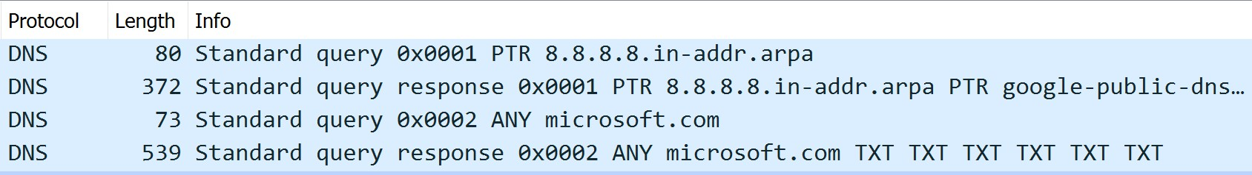
DNS Amplification Example
> dig ANY microsoft.com @8.8.8.8
microsoft.com. 21599 IN NS
ns1.msft.net.
microsoft.com. | 3599 | IN | SOA | ns1.msft.net. msnhst.microsoft.com. 2018052001 7200 600 2419200 3600
microsoft.com. | 3599 | IN | MX 10 | microsoft-com.mail.protection.outlook.com.
microsoft.com. | 3599 | IN | TXT | "facebook-domain-verification=bcas5uzlvu0s3mrw139a00os3o66wr"
microsoft.com. | 3599 | IN | TXT | "adobe-sign-verification=c1fea9b4cdd4df0d5778517f29e0934"
microsoft.com. | 3599 | IN | TXT | "facebook-domain-verification=gx5s19fp3o8aczby6a22clfhzm03as"
microsoft.com. | 3599 | IN | TXT | "v=spf1 include:_spf-a.microsoft.com include:_spf-b.microsoft.com include:_spf-c.microsoft.com
 |  |  |  | include:_spf-ssg-a.microsoft.com include:spf-a.hotmail.com ip4:147.243.128.24 ip4:147.243.128.26
 |  |  |  | ip4:147.243.1.153 ip4:147.243.1.47 ip4:147.243.1.48 -all"
microsoft.com. | 3599 | IN | TXT | "FbUF6DbkE+Aw1/wi9xgDi8KVrIIZus5v8L6tbIQZkGrQ/rVQKJi8CjQbBtWtE64ey4NJJwj5J65PIggVY
 |  |  |  | NabdQ=="
14

Slide 14
Mitigation Strategies – Connection Exhaustion
Protecting your services from connection exhaustion attacks
Configure OS level TCP/IP stack settings
  Enable tcp_tw_reuse (Linux)
  Decrease TcpTimedWaitDelay (Windows)
  Enable SYN cookies (default on newer OSs)
Configure service applications
  Web servers can mitigate against Slowloris style attacks by using an event based MPM in Apache, or using nginx either as the web server or as a reverse proxy in front
14

Slide 15
Mitigation Strategies – Connection Exhaustion
Implement an IPS and/or DDoS filtering on your NGFW
  Even if your firewall doesn’t provide DDoS protection, some IPS
services will block some types of DDoS attacks
Implement load balancing with additional servers
  Better yet, configure auto-scaling on your servers/cloud/containers
For web servers, implement a WAF at the network or server
  Web Application Firewalls can block malicious traffic and provide rate
limiting at the application layer
  ModSecurity is a free WAF that can be embedded on web servers or installed as a reverse proxy
14

Slide 16
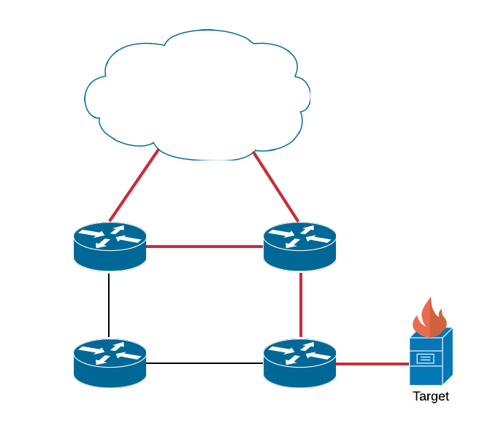
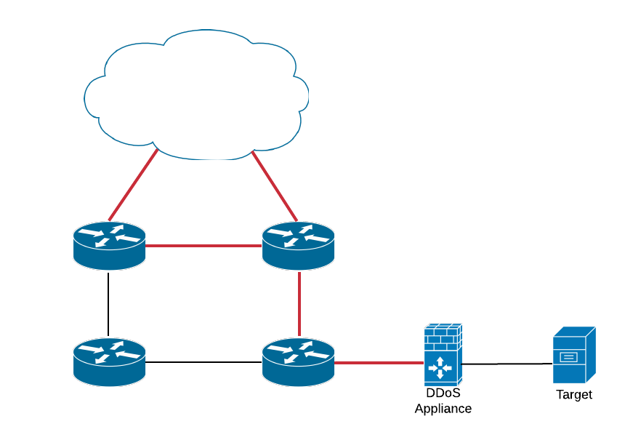

Mitigation Strategies – Connection Exhaustion
Install a dedicated on-premise DDoS filtering appliance(s)
  Pros: Low latency, high degree of control (TLS keys, data)
  Cons: Cost (CapEx), bandwidth limitations, req’d technical expertise
Attack traffic
14

Slide 17
Mitigation Strategies – Bandwidth Exhaustion
Protecting your network from bandwidth exhaustion attacks
Pro-active rate limiting
  Rate limit non-initial fragments, but exclude your recursive DNS
  Rate limit traffic from commonly abused or unwanted ports
Reactive rate limiting
  During an attack, rate limit traffic from less-critical network locations
14

Slide 18
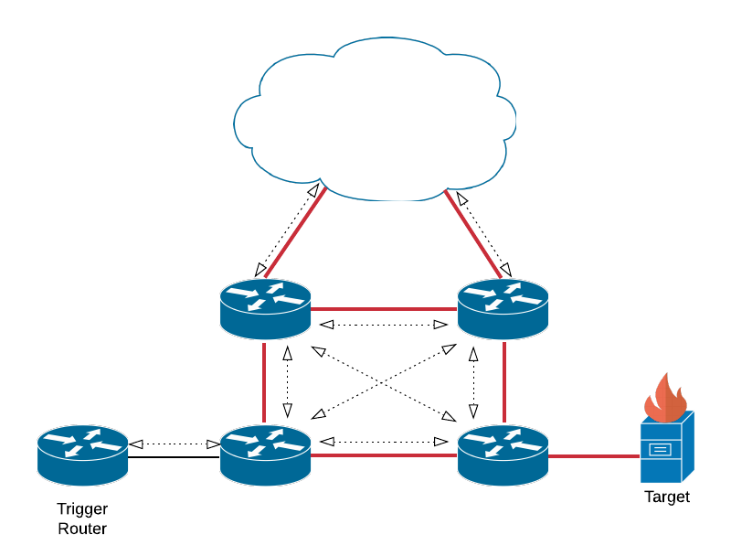
Mitigation Strategies – Bandwidth Exhaustion
Remote Triggered Black Hole (RTBH) filtering
  Locally only
Attack traffic
14

Slide 19
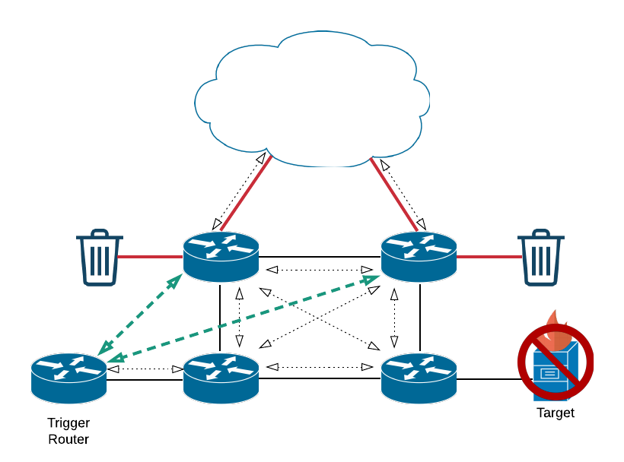
Mitigation Strategies – Bandwidth Exhaustion
Remote Triggered Black Hole (RTBH) filtering
  Locally only
Attack traffic
Signalling
14

Slide 20
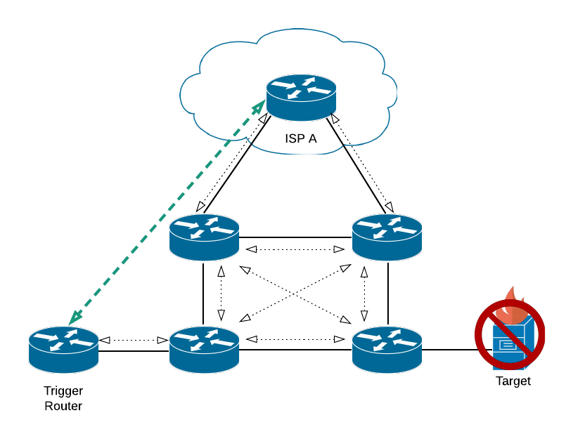
Mitigation Strategies – Bandwidth Exhaustion
Remote Triggered Black Hole (RTBH) filtering
  With your ISP
Attack traffic
Signalling
14

Slide 21
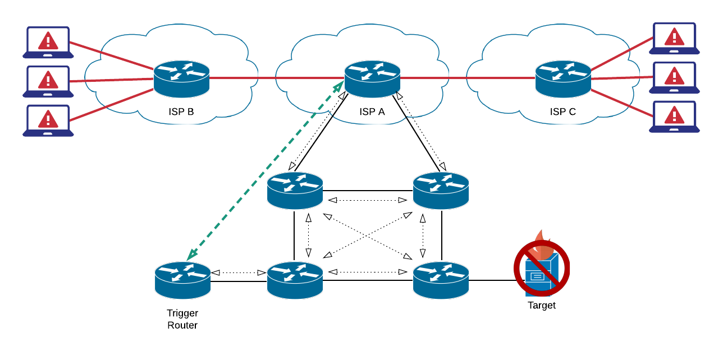
Mitigation Strategies – Bandwidth Exhaustion
Remote Triggered Black Hole (RTBH) filtering
  With your ISP
Attack traffic
Signalling
14

Slide 22
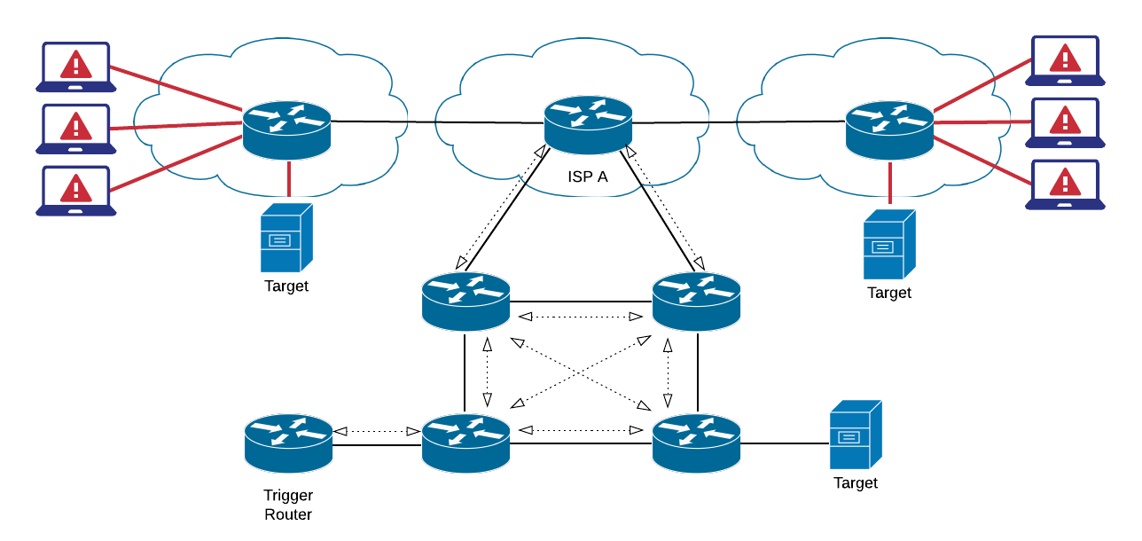
Mitigation Strategies – Bandwidth Exhaustion
Multiple Servers with Anycast
Attack traffic
14

Slide 23
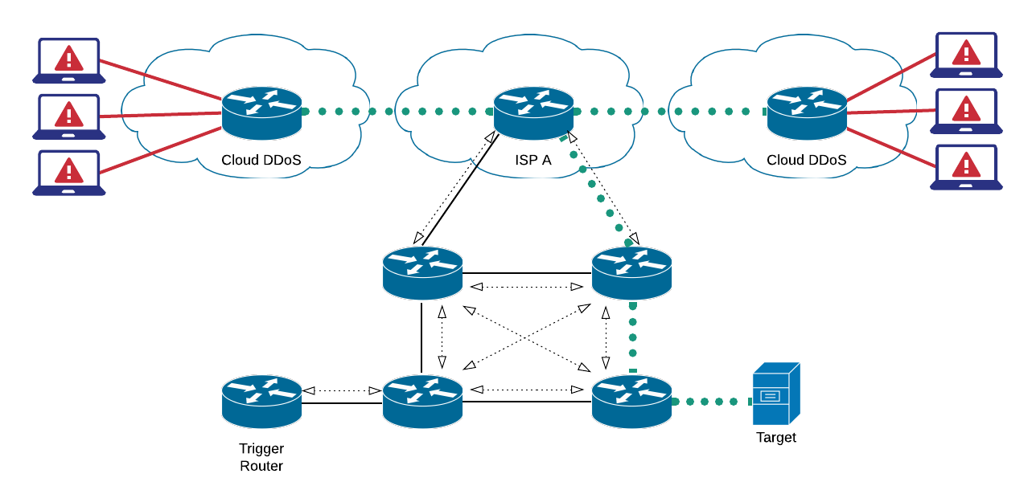

Mitigation Strategies – Bandwidth Exhaustion
Cloud-based DDoS Filtering/Scrubbing
Attack traffic
Clean traffic
(usually in a GRE tunnel)
14

Slide 24
Mitigation Strategies
Protecting your services from attacking others
Rate limiting outbound connections
Outbound filtering on source address validation
  BCP38
  Anti-spoofing filtering is also an important part of MANRS, which is part of a larger routing security initiative - www.manrs.org
Securely configure your DNS, NTP, SNMP, Memcached servers
No open resolvers!
  Only allow your own and authorised IP addresses to connect
14

Slide 25
28
v1.0
28

